Slide 1
Generating Optimized Portfolio
Team Members Group No.: 61 Panel Number:12
Project Advisors:
Dr. (Col.) Kumar P. N. / Professor / CSE
Dr. A. Senthil Kumar /Assistant Professor (SG)-Finance /ASB
S.No | Reg.No | Name of the Student | Section
1 2 3 4 | CB.EN.U4CSE18125 CB.EN.U4CSE18160 CB.EN.U4CSE18235 CB.EN.U4CSE18244 | Karthik Desai V.S.V.Akanksh Kushagra Kumar Agrawal Reddybathuni Mohan | CSE B CSE B CSE C CSE C

Slide 2
Problem Definition
Constructing equity portfolios using the prominent optimization algorithms

Slide 3

Guide Approval Mail - Screenshot

Slide 4
Review-I Comments and Justifications by Project Group

Slide 5
Actions taken (in points)
Latest data(from 31/oct/2017 to 31/oct/2021)
is collected. As the final stage of project is reached accordingly the dates will be reset

Slide 6
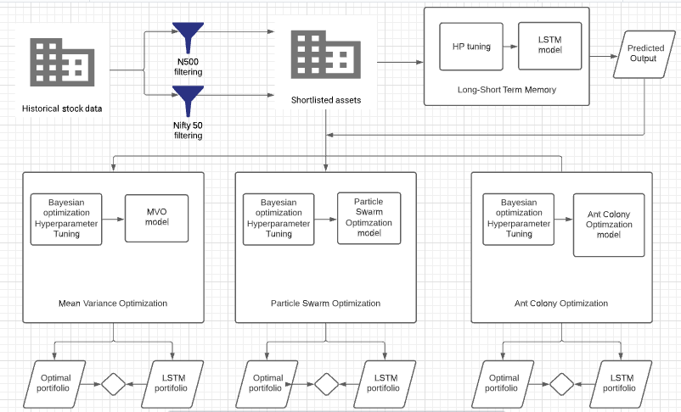
Architecture Diagram

Slide 7
Explanation of Architecture diagram
Historical data of stock market is chosen as our raw data. The data is collected from Yahoo Finance.
A few shortlisted assets are chosen from this historical data by filtering based on the sharpe and sortino ratios of Nifty 50 and N500 stock indexes which indicate excessive returns for a unit of risk.
These shortlisted assets are our final portfolio components.
The first stage is forecasting the shortlisted stock data based off an LSTM neural network. The parameters of the LSTM are hypertuned for optimal solutions.
The forecasting is followed by the portfolio optimization. The ideology is to find all possible combinations of weighted assets that provide the maximum returns and minimum risk.
Ant Colony Optimization (ACO) and Particle Swarm Optimization (PSO) are two swarm optimization algorithms that work on finding solutions based on behaviour of its swarm.
The shortlisted assets undergo these optimization algorithms to find the combination that results in maximum returns and minimum risk.
The accuracy of this combination is depicted by the sharpe/sortino ratio.

Slide 8
List all the Modules ( of the proposed Project )
Nifty Filtering
LSTM
Mean- Variance Optimization
Particle Swarm Optimization
Ant Colony Optimization

Slide 9
Module 1 : Nifty Filtering
Data Collection:
Historical data is collected from Yahoo finance.
Nifty Filtering:
Data is filtered using the below 2 criteria.
Data is available for throughout the time period.
Sortino ratio of stock must be greater than Sortino Ratio of the Nifty index.(because stock with downside volatility are considered if greater than whole nifty index sortino ratio.

Slide 10
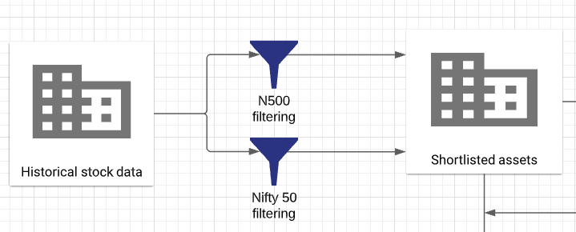
Data preprocessing and filtering

Slide 11
Module 2 (Long Short Term Memory)
The preprocessed data is taken and split into training and testing.
Hyperparameter tuning for LSTM. Hyperparameters are:
Timestep,
Batch
epoch
1. LSTM model is run on train data:
1.1Robustness check is done using (MSE,RMSE,R_square,MAPE)
2. LSTM model is run on test data and validates itself with real data.
2.1 Robustness check is done using (MSE,RMSE,R_square,MAPE)

Slide 12
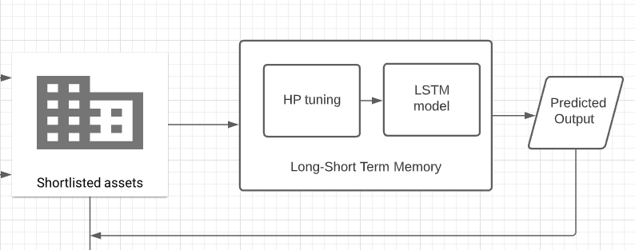
Long Short Term Memory

Slide 13
Module 3 (Mean Variance Optimization)
Variables are initialized and assigned which are required for MVO. Such as
For each stock daily return data frame is created
Trading days is calculated
Annualized covariance matrix for sharpe and sortino ratios are made
Weights for each stock is allocated which sum up to 1
Returns and risk are calculated
The MVO is run for many iterations(yet to decide) for each iteration the sharpe ratio and sortino ratio portfolio are stored as dataframe.

Slide 14
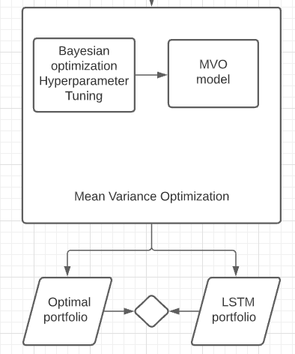
Mean Variance Optimization

Slide 15
Module 4 (Particle Swarm Optimization)
Variables are initialized and assigned which are required for PSO. Such as
For each stock daily return dataframe is created
Trading days is calculated
Annualized covariance matrix for sharpe and sortino ratios are made
Weights for each stock is allocated which sum up to 1
Returns and risk are calculated
PSO Model is tuned using Bayesian optimization (for parameters as Swarm size,iterations)
There is fitness function check and particles’ velocity and position update formula for finding the optimum solution over each iterations

Slide 16
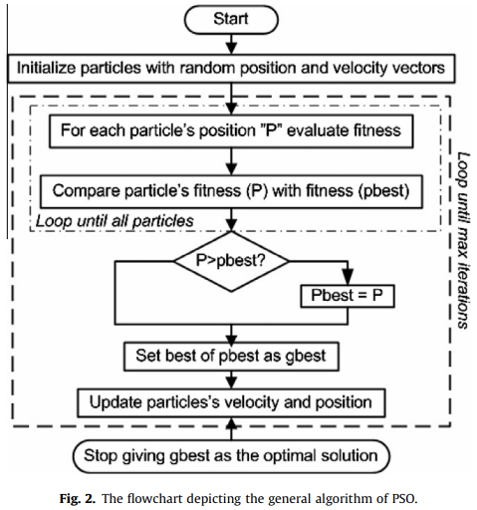
Particle Swarm Optimization

Slide 17
Module 5 (Ant Colony Optimization)
Ants deposit pheromone as they walk and find their route by walking along the pheromone deposition. Density of pheromone increases as they walk back to source with food. Pheromone deposition is proportional to the number of ants.
Returns for sortino for positive returns are nulled as sortino measures the assets changes from a downfall deviation. Sharpe takes both positive and negative returns.
Covariance of annualised returns are calculated for evaluating standard deviation.
Random probability are initialised and based off these values , the ants determine the next pheromone update by updation formula. To avoid initial pheromone preferability, an evaporation update is done to make sure the ants search for the best fitness values globally.
The global weights are the final component for the parts of investment and fitness values determine the accuracy of each weighted combination of assets.
We have performed Bayesian optimization for the hyperparameter tuning in ACO since they maximise the loss function and returns globally highest parameters. Framework for Bayesian hyperparameter optimization- Optuna

Slide 18
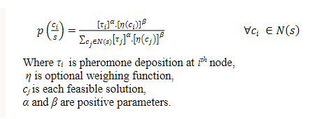
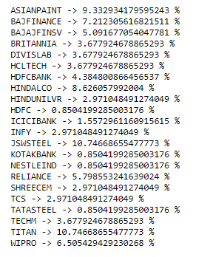

Module 5 (Ant Colony Optimization)

Slide 19
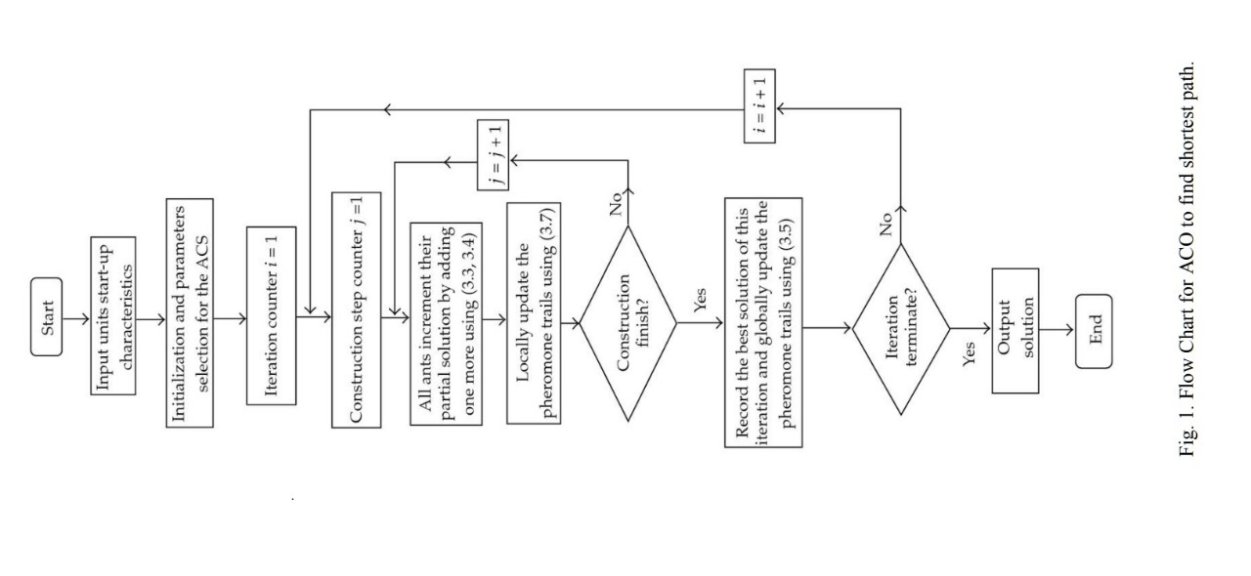
Ant Colony Optimization

Slide 20
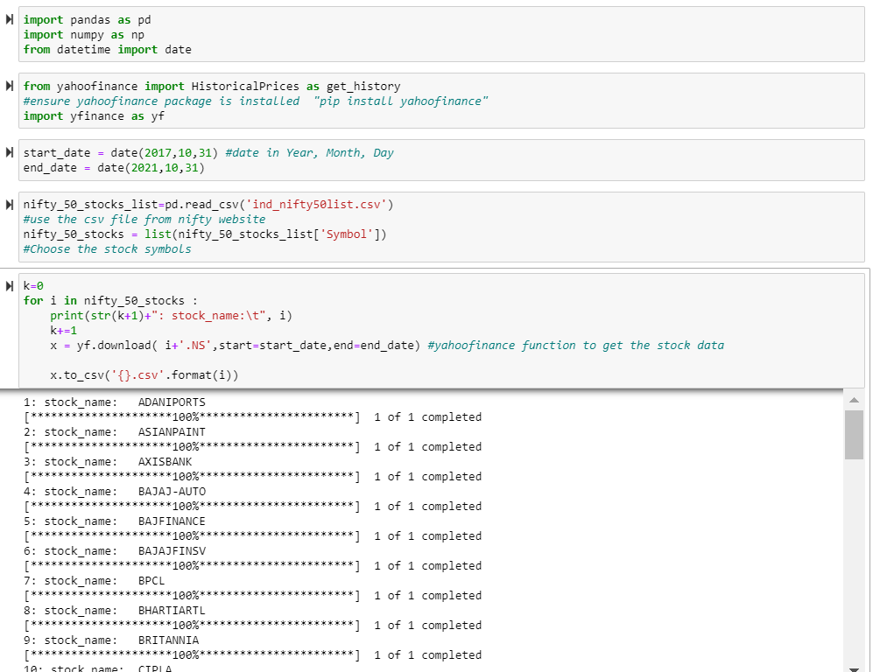
Implementations/Results obtained
FILTERING CODE:

Slide 21
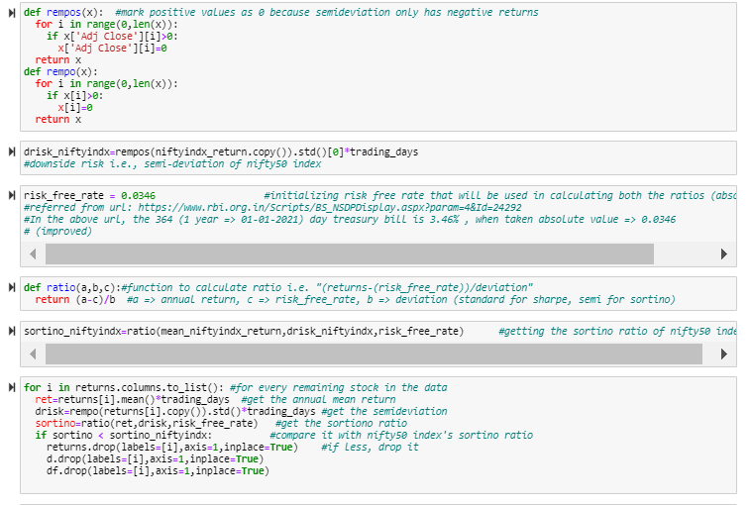
Implementations/Results obtained

Slide 22
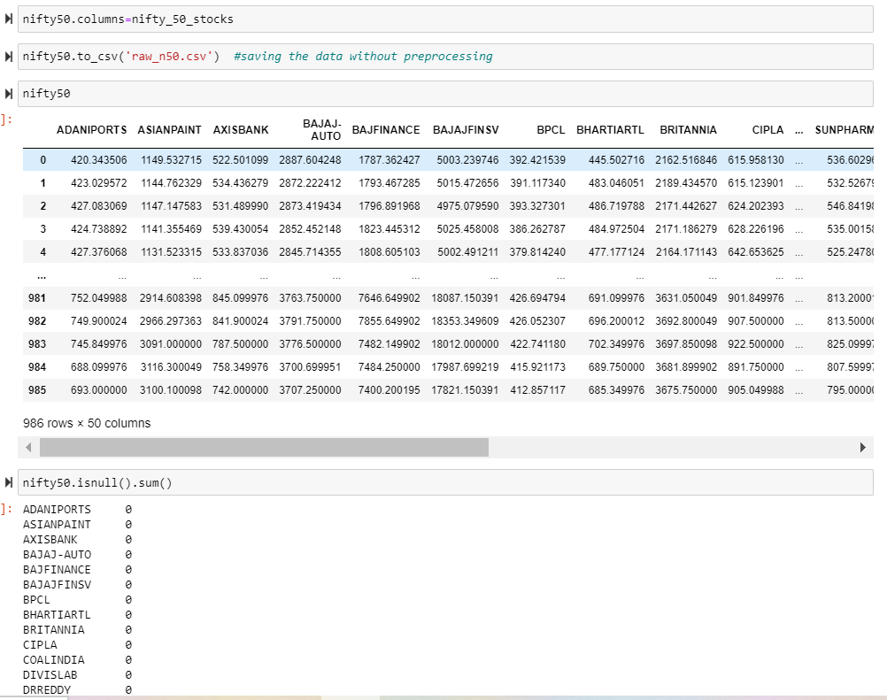
Implementations/Results obtained

Slide 23
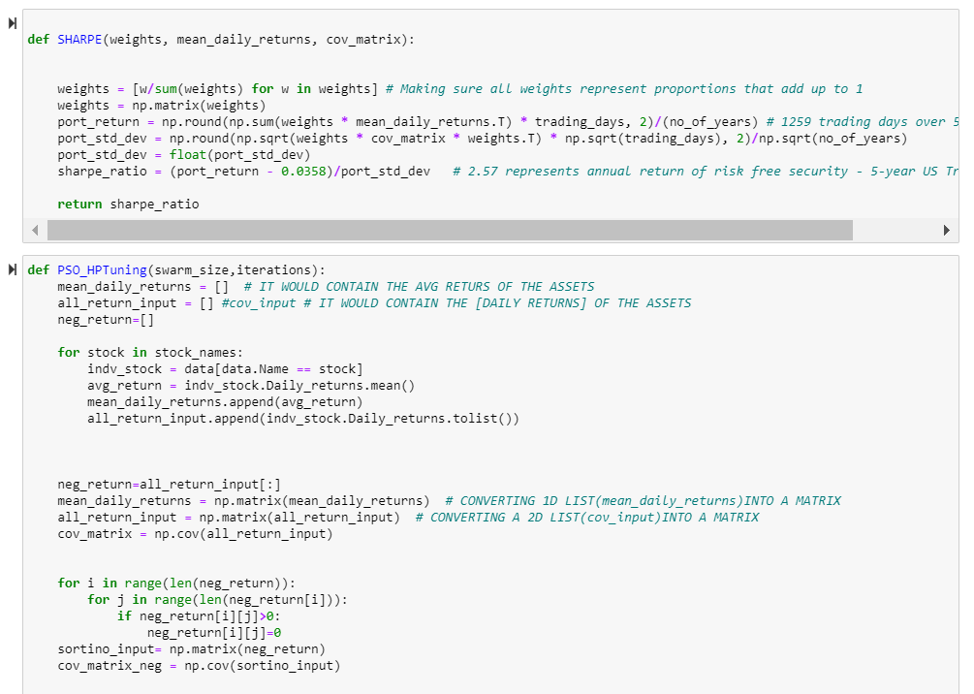
Implementations/Results obtained
PSO CODE:

Slide 24
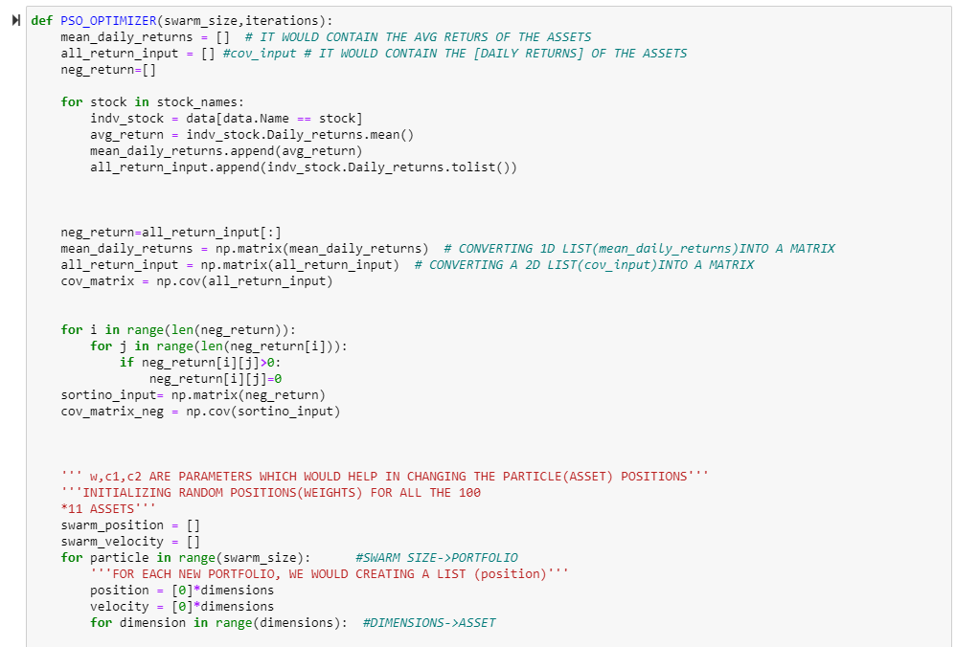
Implementations/Results obtained

Slide 25
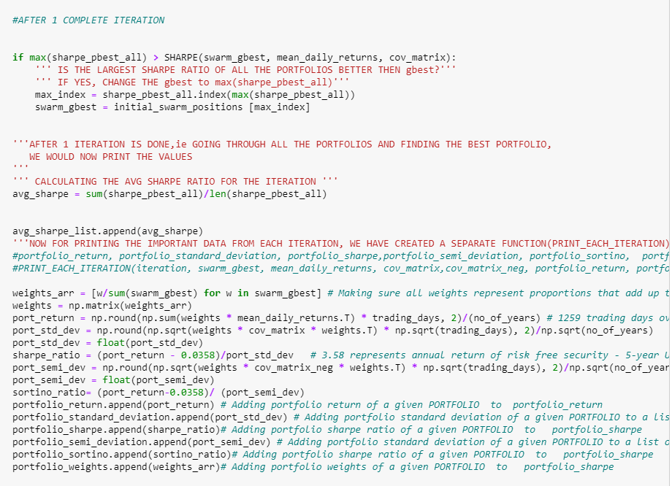
Implementations/Results obtained

Slide 26
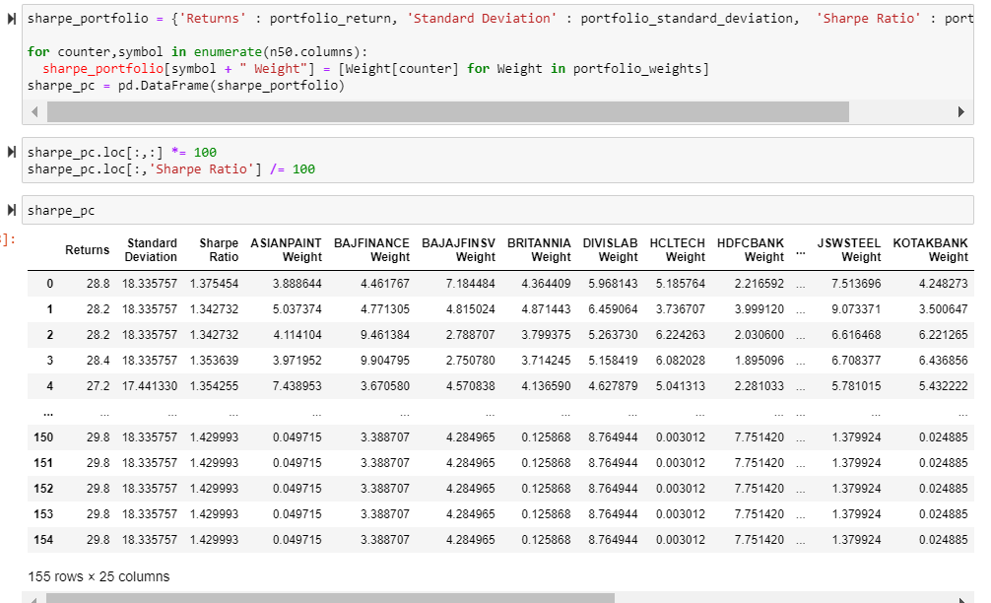
Implementations/Results obtained

Slide 27
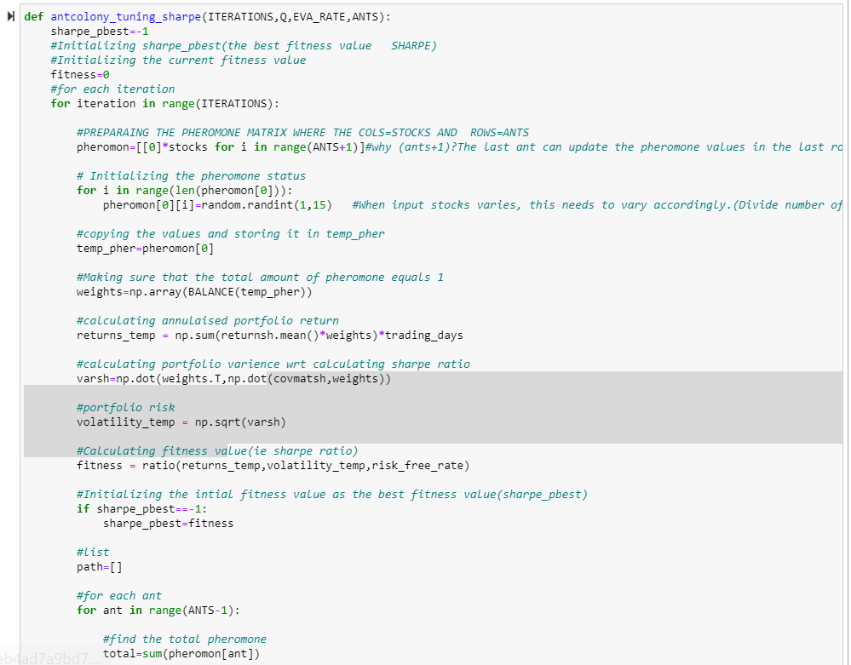
Implementations/Results obtained
ACO CODE

Slide 28
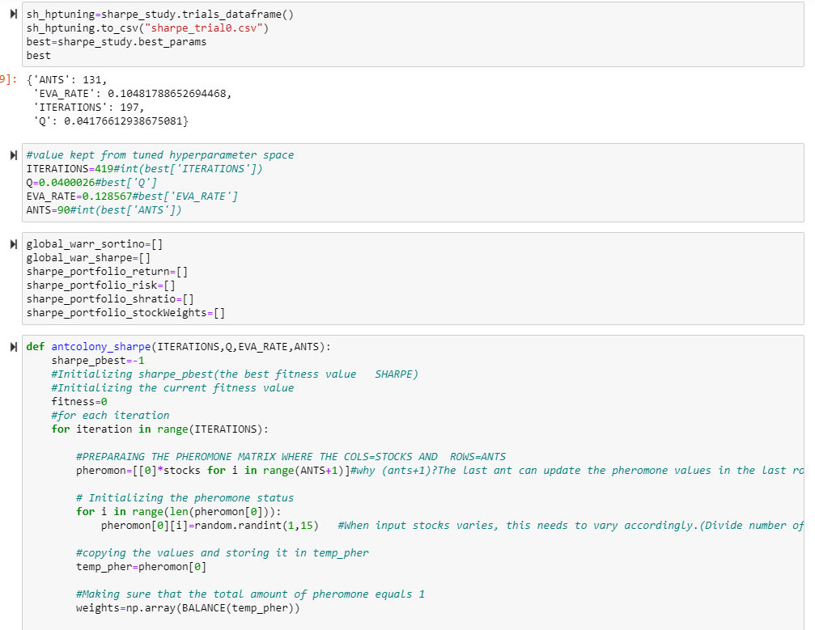
Implementations/Results obtained

Slide 29
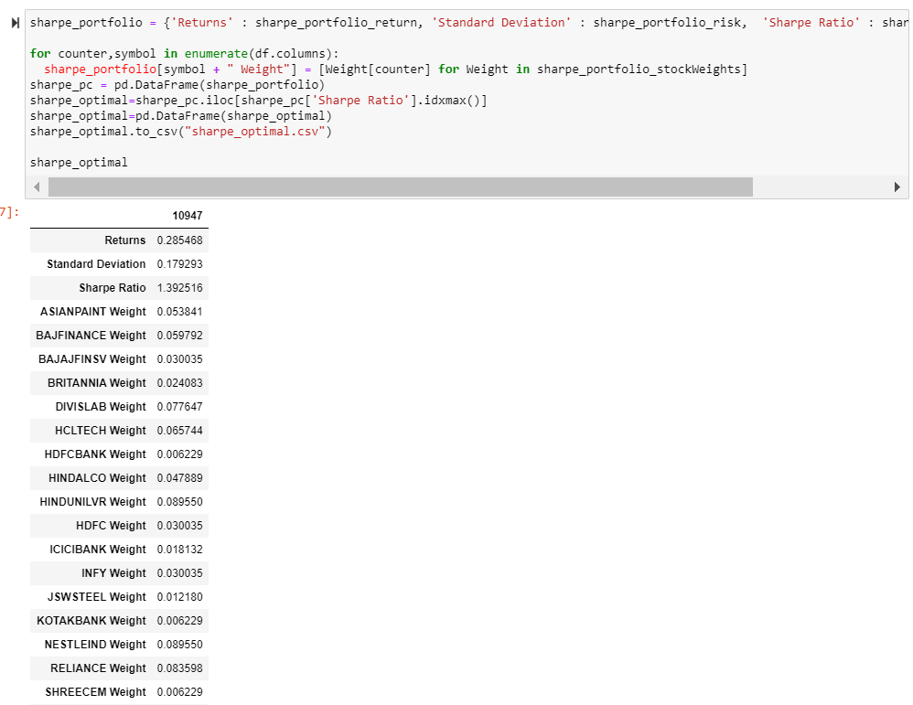
Implementations/Results obtained

Slide 30
CONCLUSION
The historical data is filtered using Nifty50 and N500 indices.
The filtered company dataset is taken to LSTM for training and testing.
After predicting the the stock values, Portfolio Optimizations(MVO,PSO,ACO) are executed.
The Portfolio from each optimization algorithm is considered with max sharpe/Sortino ratio.

Slide 31
References
[1] Hanhong Zhu, Yi Wang, Kesheng Wang, Yun Chen, Particle Swarm Optimization (PSO) for the constrained portfolio optimization problem, Expert Systems with Applications, Volume 38, Issue 8, 2011,
[2]Saud Almahdi, Steve Y. Yang, A constrained portfolio trading system using particle swarm algorithm and recurrent reinforcement learning, Expert Systems with Applications, Volume 130, 2019
[3] Carlos Betancourt, Wen-Hui Chen,Deep reinforcement learning for portfolio management of markets with a dynamic number of assets, Expert Systems with Applications, Volume 164,2021
[4] Akhter Mohiuddin Rather, Arun Agarwal, V.N.Sastry. “Recurrent neural network and a hybrid model for prediction of stock return”. Expert Systems with Application, Vol 42, Issue 6, 15 April 2015..
[5] Shile Chen And Changjun Zhou . “Stock Prediction Based on Genetic Algorithm Feature Selection and Long Short-Term Memory Neural Network ”.College of Mathematics and Computer Science , December 2020.
[6] Anita Yadav, C K Jha , Aditi Sharan.”Optimizing LSTM for time series prediction in Indian stock market”.
International Conference on Computational Intelligence and Data Science (ICCIDS 2019).

Slide 32
References
[7] Jithin Eapen,Abhishek Verma,Doina Bein.”Novel Deep Learning Model with CNN and Bi-Directional LSTM for Improved Stock Market Index Prediction”. IEEE (Institute of Electrical and Electronics Engineers) Xplore 2019
[8] Murtaza Roondiwala , Harshal Patel, Shraddha Varma. “Predicting Stock Prices Using LSTM”.International Journal of Science and Research (IJSR),Volume 6 Issue 4, April 2017.
[9] Adil Moghar,Mhamed Hamiche“Stock Market Prediction Using LSTM Recurrent Neural Network”.(IWSMAI 2020)
[10] Kambiz Forqandoost Haqiqi and Tohid Kazemi,”Ant Colony Optimization Approach to Portfolio Optimization – A Lingo Companion”.International Journal of Trade, Economics and Finance, Vol. 3, No. 2, April 2012
[11]Arushi Gupta,Smriti Srivastava,“Comparative Analysis of Ant Colony and Particle Swarm
Optimization Algorithms for Distance Optimization”,(ICITETM 2020)
[12] Saranya, K. and Prasanna, P. K. (2014). “Portfolio selection and optimization with higher moments: Evidence from the indian stock market.”Asia-Pacific Financial Mar-kets, 21(2), 133–149

Slide 33
References
[13] Boris Georgiev.”Constrained Mean-Variance Portfolio Optimization with Alternative Return Estimation”. International Atlantic Economic Society 2014.
[14] Senthilkumar, A., Namboothiri, A., & Rajeev, S. (2021). Does portfolio optimization favor sector or broad market investments? Journal of Public Affairs, e02752. https://doi.org/10.1002/pa.2752

Slide 34
THANK YOU

